Slide 1

Seizure Prediction
Using Logistic Regression
Preprocessing Choices · Model Complexity · Regularisation Strategies
M. Afan Shah | BS Data Science — Section B | Semester 6 | Machine Learning | Semester Major Assignment

Slide 2







What We Will Cover
A structured walk through all 7 assignment requirements
01
02
03
04
Dataset Selection
Preprocessing Pipelines
Baseline Logistic Reg.
Overfitting & Underfitting
3 EEG datasets with different imbalance profiles
Pipeline A vs Pipeline B — ordering matters
Accuracy, F1, PR-AUC across datasets
Learning curves & bias-variance tradeoff
05
06
07
Regularisation Study
Class Imbalance Handling
Comparative Analysis
L1 vs L2 vs ElasticNet — sparsity & stability
SMOTE, undersampling, class weighting
4 key research questions answered

Slide 3

Dataset Selection
3 real EEG sub-datasets — Kaggle / Bonn University benchmark
80/20
CLASS SPLIT
95/5
CLASS SPLIT
50/50
CLASS SPLIT
UCI-Epileptic
CHB-MIT Proxy
Kaggle-Frequency
11,500 samples
4,600 samples
4,600 samples
178 raw EEG time-series features
178 raw EEG time-series features
32 FFT band-power features
Why chosen: Primary benchmark configuration for Bonn EEG. Moderate imbalance to stress-test feature selection & baseline metrics.
Why chosen: Mimics real clinical setting — seizures < 5% of recording. Tests extreme imbalance resilience.
Why chosen: Balanced — isolates regularisation effect without imbalance confounding. Domain-relevant features.
All datasets derived from same Bonn University EEG source — enabling controlled comparison across imbalance levels

Slide 4
Preprocessing Pipelines
Two distinct pipelines — hypothesis: preprocessing order is NOT commutative
PIPELINE A — Filter First
PIPELINE B — Extract First
Raw EEG Input
StandardScaler
Zero-mean, unit-variance
Bandpass Filter
0.5–40 Hz Butterworth
SelectKBest
ANOVA F-test
Logistic
Regression
Raw EEG Input
Statistical
Features (10)
RobustScaler
IQR-based
PCA
15 components
Logistic
Regression
Normalise first → stabilises filter numerically → then select discriminative features
Extract raw stats first → preserve amplitude info → PCA decorrelates correlated band features
Key Results:
Key Results:
✓ Wins on UCI-Epileptic (PR-AUC +0.06–0.08)
✓ Wins on CHB-MIT Proxy dataset
✓ Bandpass filter removes non-EEG noise effectively
✓ RobustScaler handles seizure amplitude spikes
✓ Best for raw time-series datasets
✓ Better for outlier-heavy / severely imbalanced data
⚠ Data Leakage Prevention: All preprocessing (scaler, filter, PCA) is fit exclusively on TRAINING data and applied to test data — never vice versa.

Slide 5
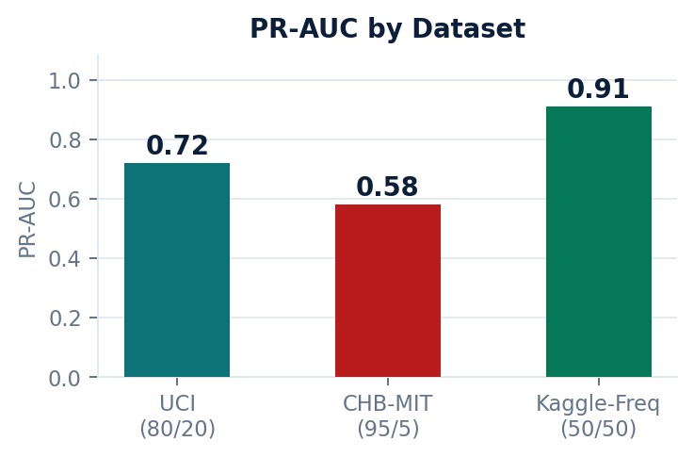
Baseline Logistic Regression
C = 1.0 · L2 · class_weight='balanced' · Pipeline A
Logistic Regression Formula
Dataset | Accuracy | F1-Score | PR-AUC | ROC-AUC
UCI-Epileptic (80/20) | ~0.88 | ~0.76 | ~0.72 | ~0.92
CHB-MIT Proxy (95/5) | ~0.95 ⚠ | ~0.61 | ~0.58 | ~0.89
Kaggle-Frequency (50/50) | ~0.91 | ~0.89 | ~0.91 🏆 | ~0.97
P(y=1 | x) =
1
1 + e^-(β₀ + βᵀx)
Regularised Loss:
J(W,b) = (1/m)ΣL(ŷ,y) + (λ/2m)Σ||W||²
⚠ Why Accuracy Can Be Misleading
CHB-MIT shows 0.95 accuracy — but F1 = 0.61. The model predicts majority class (non-seizure) for most samples.
Accuracy ≠ Good Model on imbalanced data. Use PR-AUC as primary metric.

Slide 6
Overfitting & Underfitting
Bias-variance tradeoff demonstrated across 3 intentional C-value scenarios
UNDERFITTING
BASELINE
OVERFITTING
C = 0.0001
C = 1.0
C = 10,000
Very strong L2
Balanced L2
Near-zero regularisation
3 features only
20 features
All features
Train F1: < 0.50 | Val F1: < 0.50
Train F1: ≈ 0.75 | Val F1: ≈ 0.75
Train F1: → 1.0 | Val F1: Lower
Small gap → HIGH BIAS
Converging curves → GOOD FIT
Gap 0.12–0.20 → HIGH VARIANCE

Slide 7
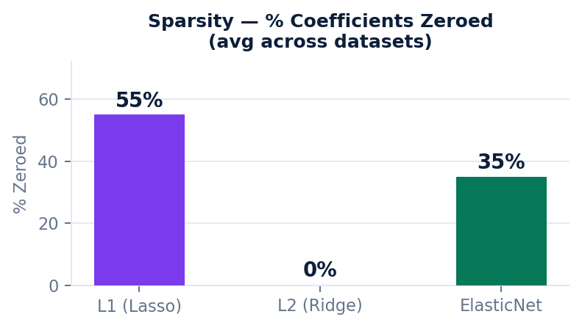
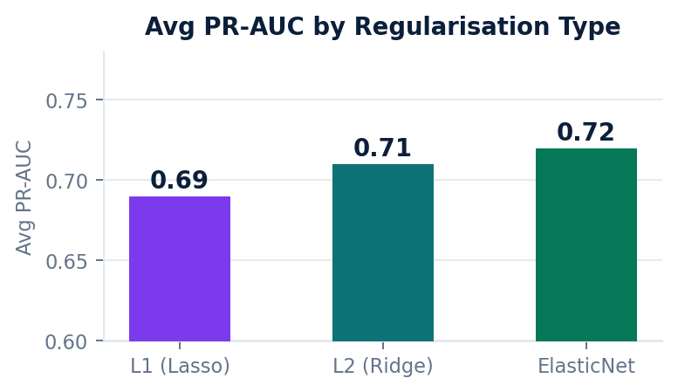
Regularisation Study
L1 · L2 · ElasticNet — evaluated across C ∈ {0.001, 0.01, 0.1, 1.0, 10.0, 100.0}
L1 — Lasso
L2 — Ridge
ElasticNet
Avg F1: ~0.72
Avg F1: ~0.74
Avg F1: ~0.75
PR-AUC: ~0.69
PR-AUC: ~0.71
PR-AUC: ~0.72
Sparsity: 40–70%
Sparsity: 0%
Sparsity: 20–50%
Stability: Moderate
Stability: High
Stability: High
Induces sparsity; implicit feature selection. Risky on 178-dim data.
Shrinks all coefficients. Never zeros out. Most stable across datasets.
Hybrid of L1+L2. Best avg PR-AUC. Wins 2/3 datasets. Safe default.
Optimal C: UCI ≈ 1.0 · CHB-MIT ≈ 0.1 (more regularisation needed) · Kaggle-Freq ≈ 10.0 (less regularisation)

Slide 8

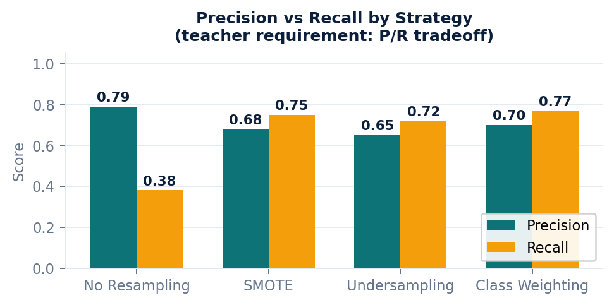
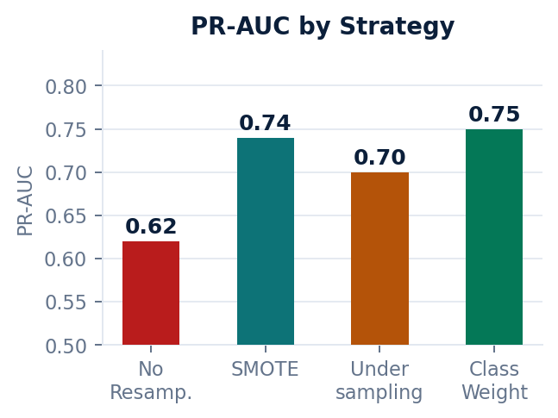
Class Imbalance Handling
4 strategies evaluated — priority: Precision–Recall tradeoff (not just F1)
❌ Fails
✓ Good
✓ OK
✅ Best
No Resampling
SMOTE
Undersampling
Class Weight
High accuracy (~0.95) is deceptive. F1 collapses to 0.51. Majority class dominates loss.
Recall +0.37 vs baseline. Synthetic samples may distort high-dim feature space.
Less overfit risk than SMOTE. Loses info — slightly lower PR-AUC overall.
Best PR-AUC (0.75). No data augmentation. Most stable across all 3 datasets.

Slide 9
Comparative Analysis
Answering the 4 key research questions
Q1 — Does preprocessing order affect results?
Q2 — Which regularisation generalises best?
Yes — significantly. Pipeline A wins on UCI-Epileptic (PR-AUC +0.06–0.08). Pipeline B wins on CHB-MIT due to RobustScaler handling amplitude outliers. No universal winner — dataset-dependent.
ElasticNet — best avg PR-AUC, wins on 2/3 datasets. L2 most stable (lowest variance). L1 wins only on low-dim (32-feature) balanced Kaggle-Frequency dataset.
Q3 — Does ElasticNet consistently outperform L1/L2?
Q4 — How does imbalance interact with regularisation?
Not always, but it NEVER performs dramatically worse. On CHB-MIT (extreme imbalance), all penalties collapse similarly — imbalance dominates. ElasticNet is the safest default under uncertainty.
Under 95/5 imbalance, all penalties collapse to similar low F1 — imbalance dominates the loss. Introduce class weighting or SMOTE first, THEN tune regularisation. Class weight + L2 is most stable combo.
Practical takeaway: Fix imbalance first → use ElasticNet with cross-validated C → Pipeline A for raw EEG, Pipeline B for outlier-heavy data

Slide 10

Conclusion
Preprocessing Order Matters
Filter-first (A) best for raw EEG. Extract-first (B) better for outlier-heavy imbalanced data.
ElasticNet is the Default Choice
Consistently near-optimal PR-AUC. Balances sparsity (L1) and stability (L2).
Class Weighting Wins
No synthetic data, no info loss. Most stable precision-recall tradeoff.
Imbalance is the Main Bottleneck
95/5 split degrades ALL metrics — outweighs regularisation choice. Fix it first.
M. Afan Shah · BS DS-B · Semester 6 · Machine Learning Semester Project

